Slide 1
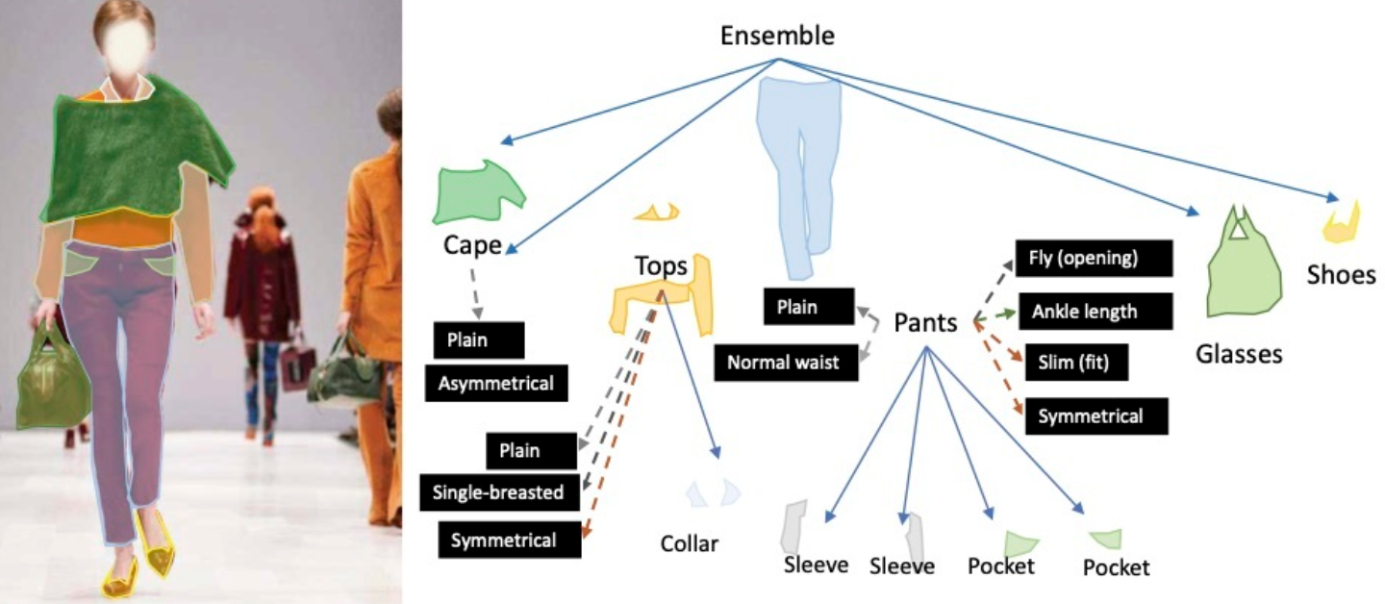

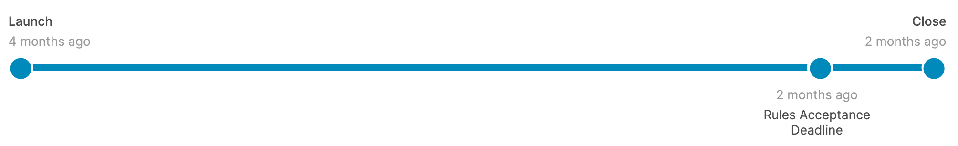
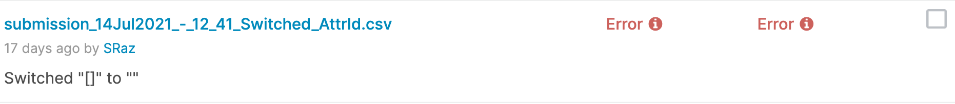
iFashion Materialist2021
Sagi Ziv
Shahar Raz
Introduction to Computer Vision 2021B
Submissions

Slide 2
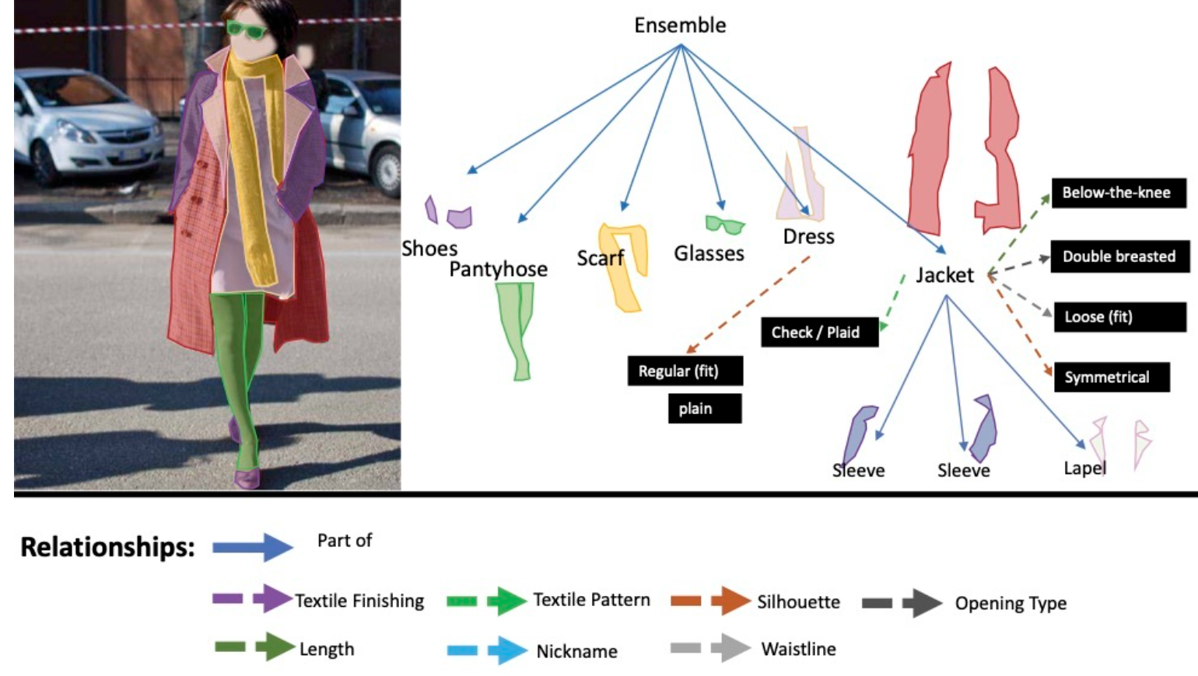
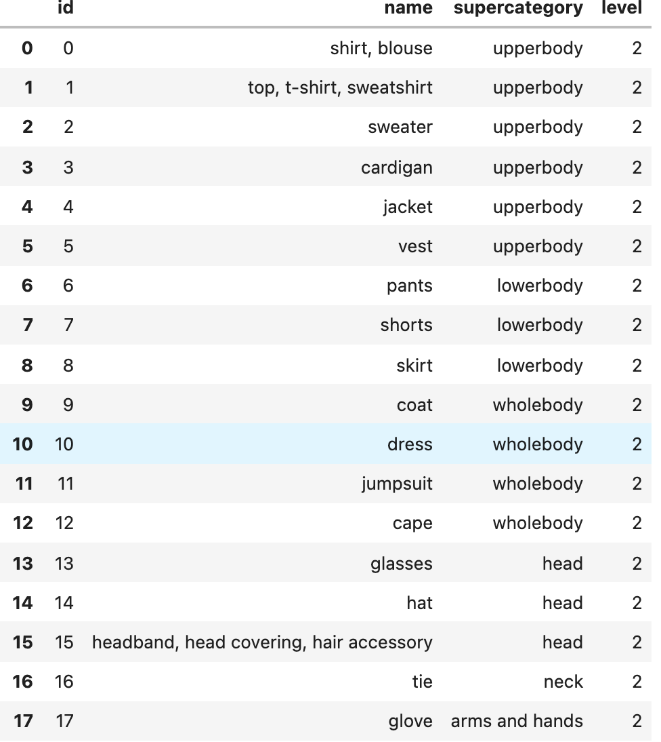
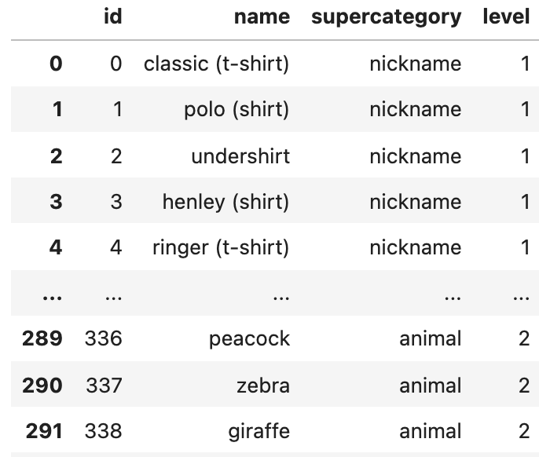
Goals
Main Goals:
detect cloths in a picture, and extract the item’s mask from the photo ( Fine-grained Segmentation ).
predict it’s class (Shirt, Shoes…),
Moreover, it is needed to find Attributes (In black).

Slide 3
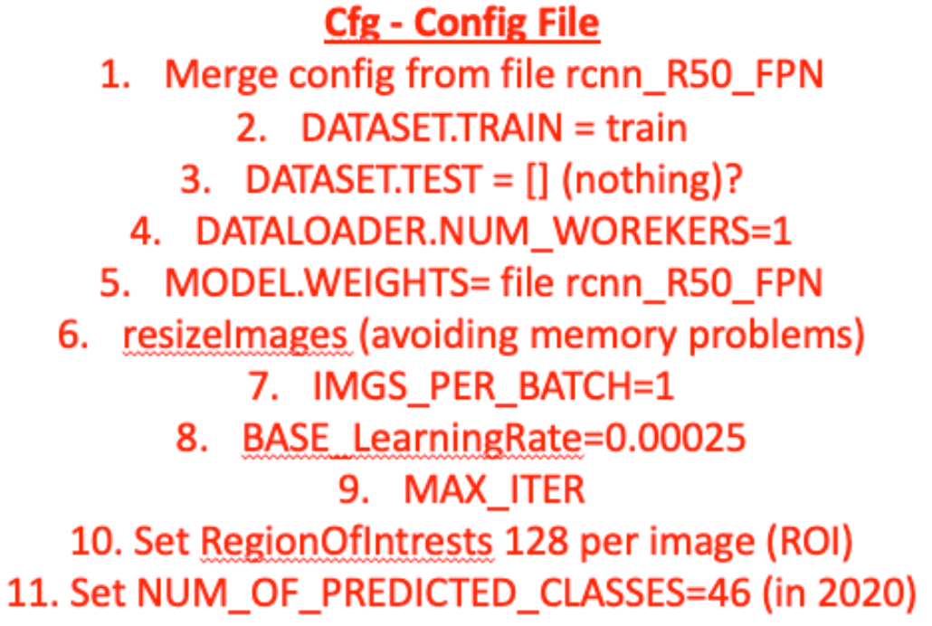
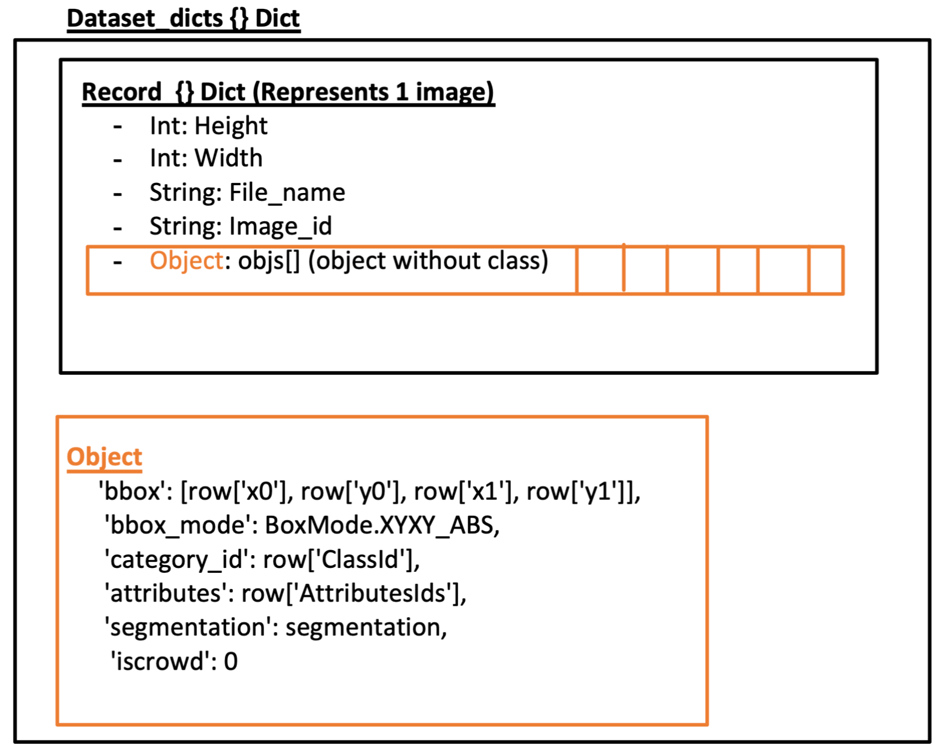
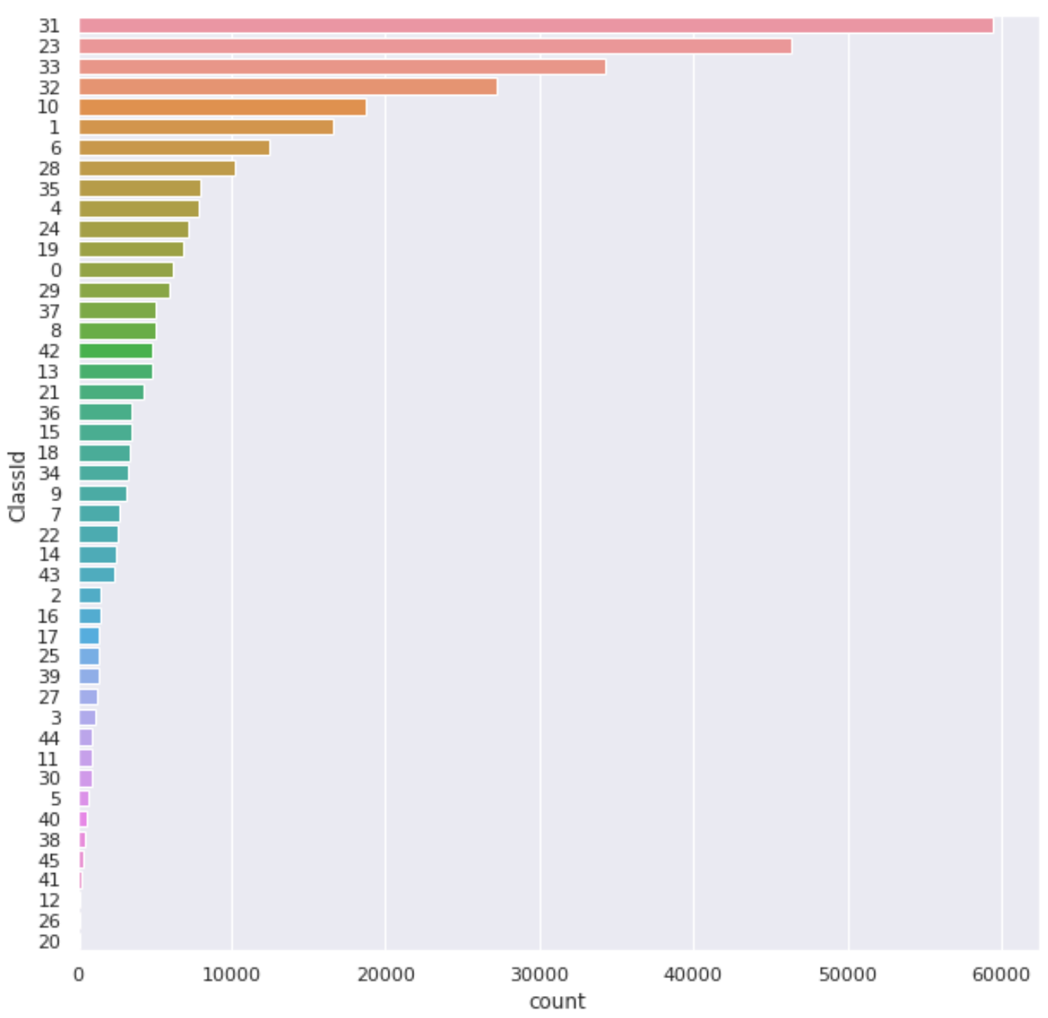
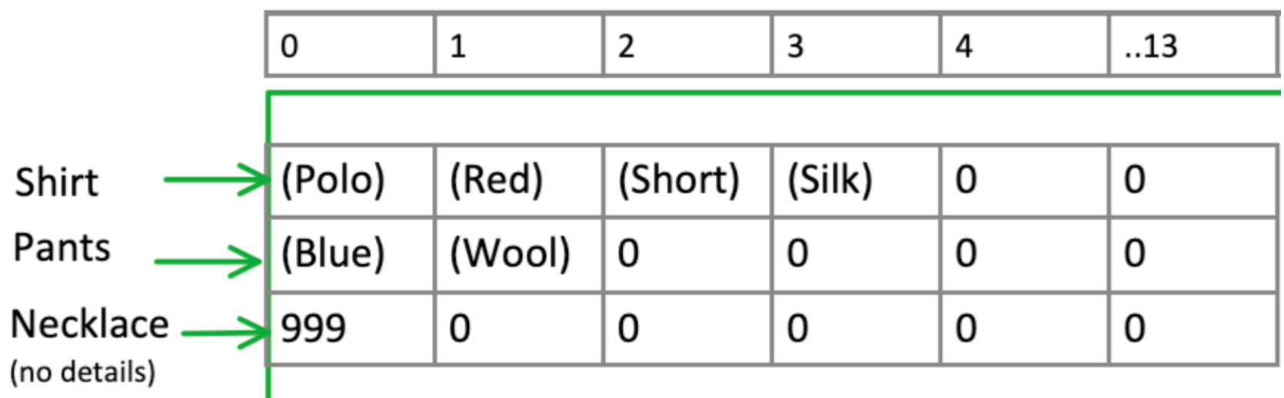
Our Additions to the original Notebook
Main Points: Sagi Shahar
EDA - Exploratory Data Analysis - We examined the classes distribution.
Adding Github I/O (fetching Tokens for colab).
Fixed Env setup - import bugs (uploaded a working version to private Mega, so it doesn’t rely on vary versions).
Added drawings of data structures & processes.
Added submission file creation code.
Save & Read trained models.
Modify Detectron2’s Fast-RCNN output layers to include Attributes.

Slide 4
Difficulties encountered
Setup Env (installing Detectron2) - Solved by researching Online. Happened 2 times, so we saved env to a file, and uploaded to private server.
Working with Detectron2 - Study for days and create drawings. (config file, input format, objects structures’, train routine, dataMapper etc..)
Each run takes at least 15 minutes before getting to train loop, Kaggle GPU time ended - 1. run on colab . 2. run submission file modification in different colab notebook 3. save df after calcs to file.
Not enough storage space in colab to unzip all the training data - Purchased Colab Pro
Submission RLE encoding out of bound. We discovered that 2020 - 2021 test_names are the same, but image_sizes are not. (days of debugging) - changed dataset file
Cryptic errors when submitting the file (" one or more rows has odd number of values") (days of debugging) - fixing RLE encoding for images without predictions.

Slide 5
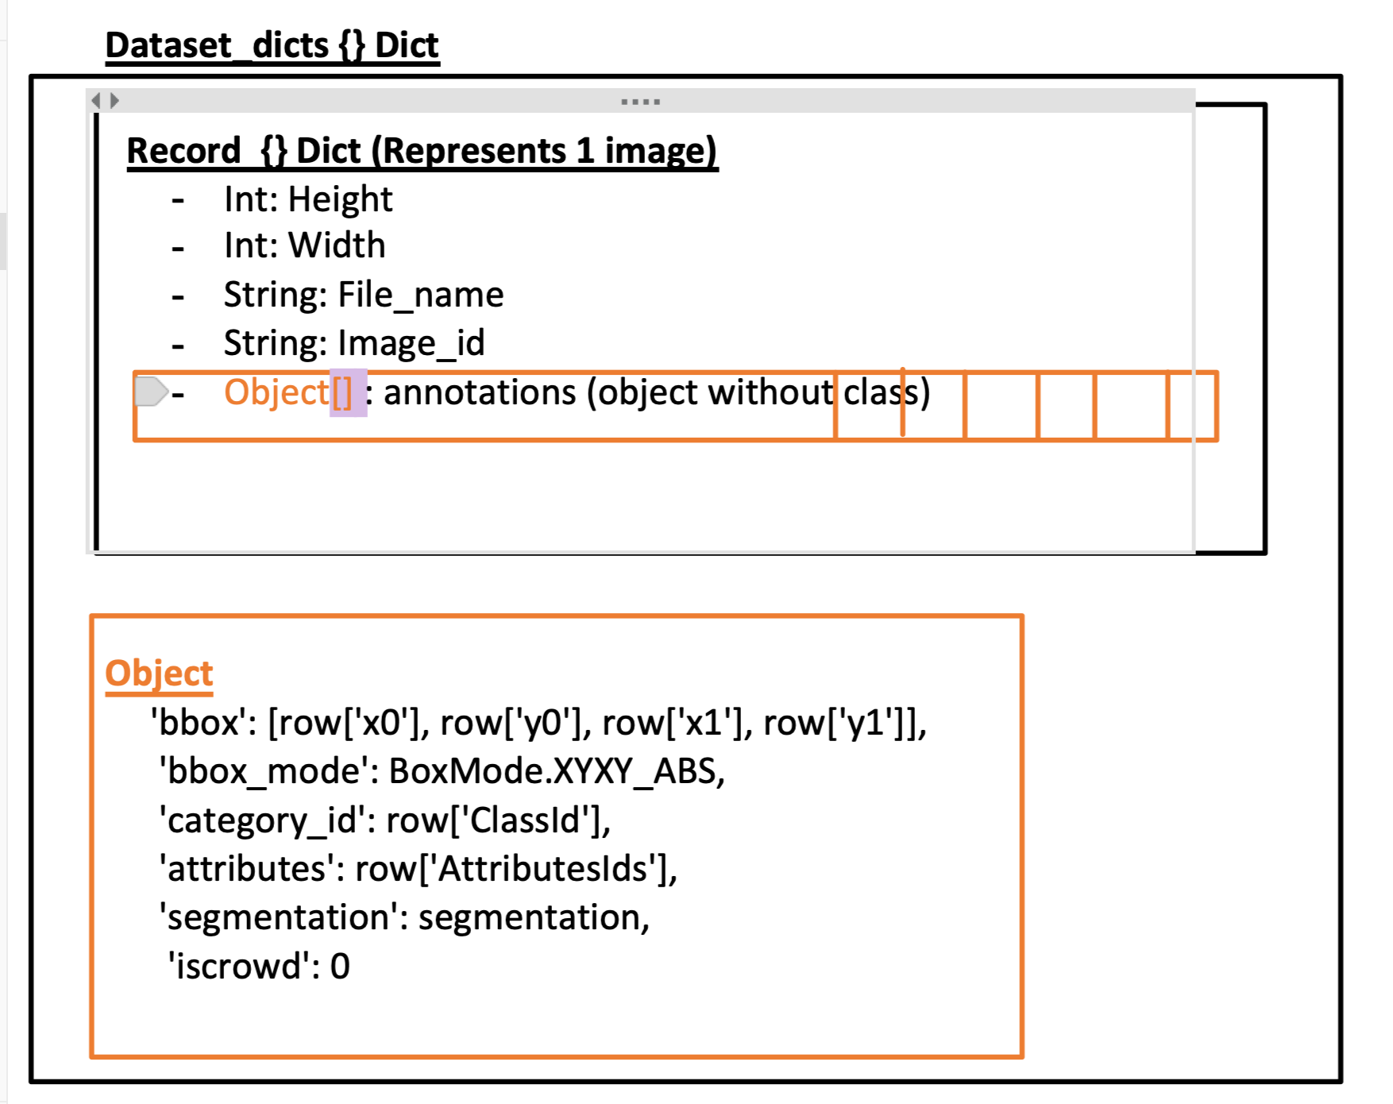
References
Our Work
Kaggle Notebook
Onenote Notebook
Detectron Config & Dataloader
Edit Submission File
Main References:
Detectron2 2020
Github fashion 2019
detectron2 doc
lb0.1213
Starter EDA + Mask RCNN
1st place 2020 architecture

Slide 6
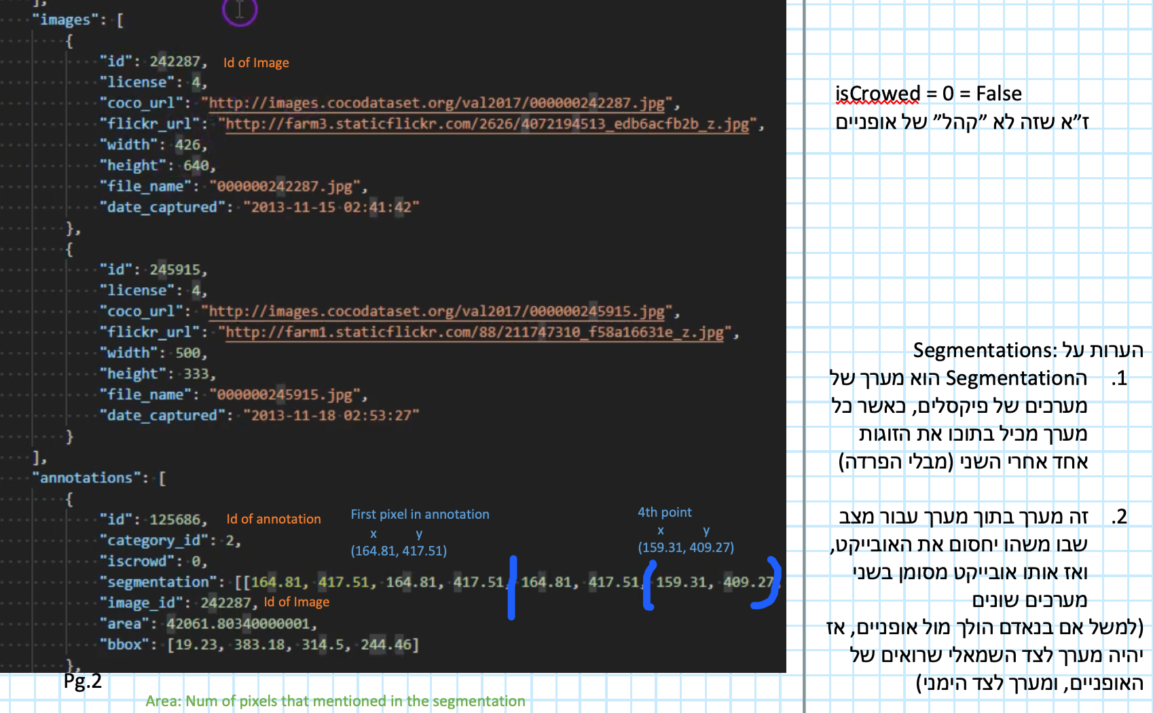
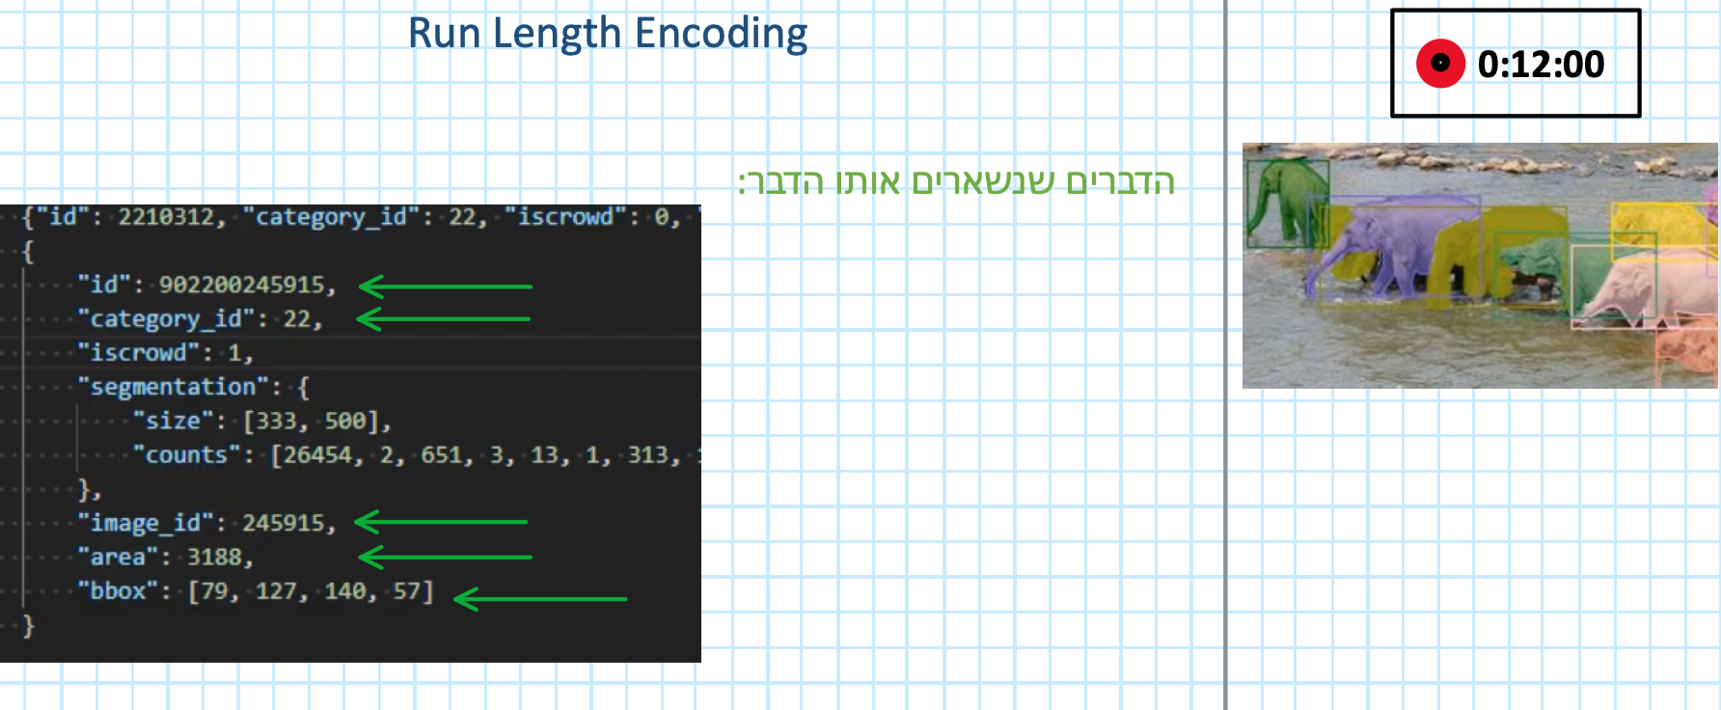
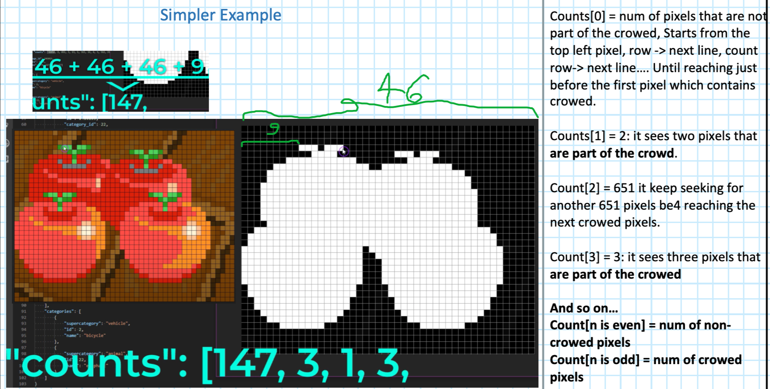
COCO Dataset Format

Slide 7
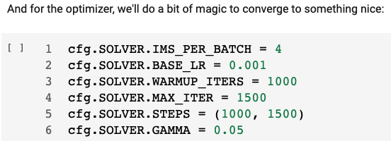
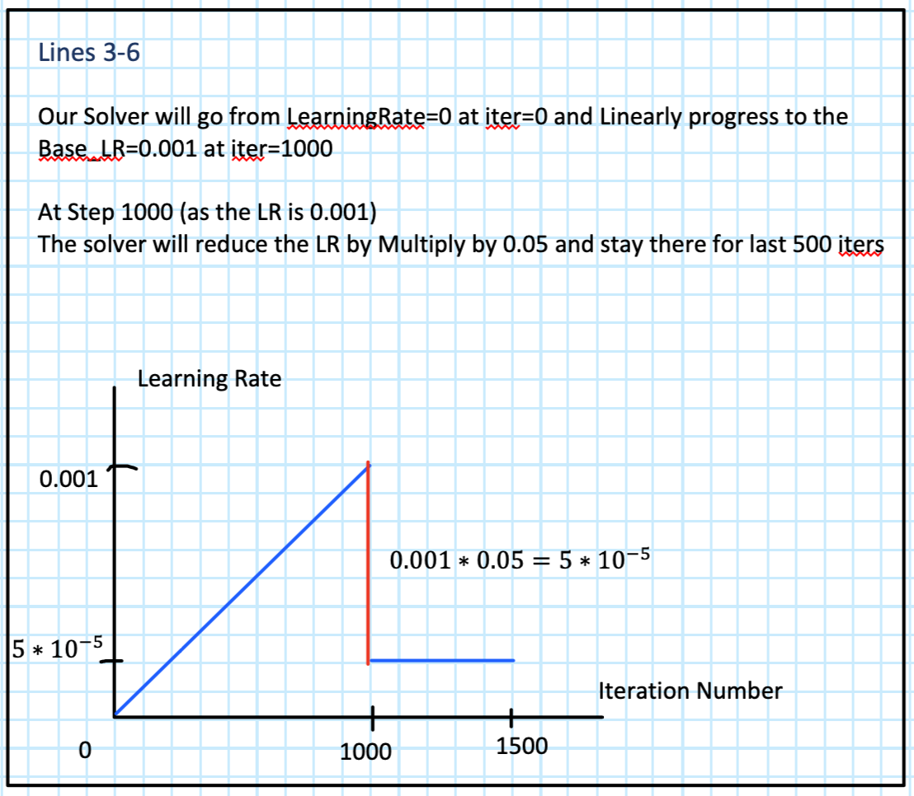
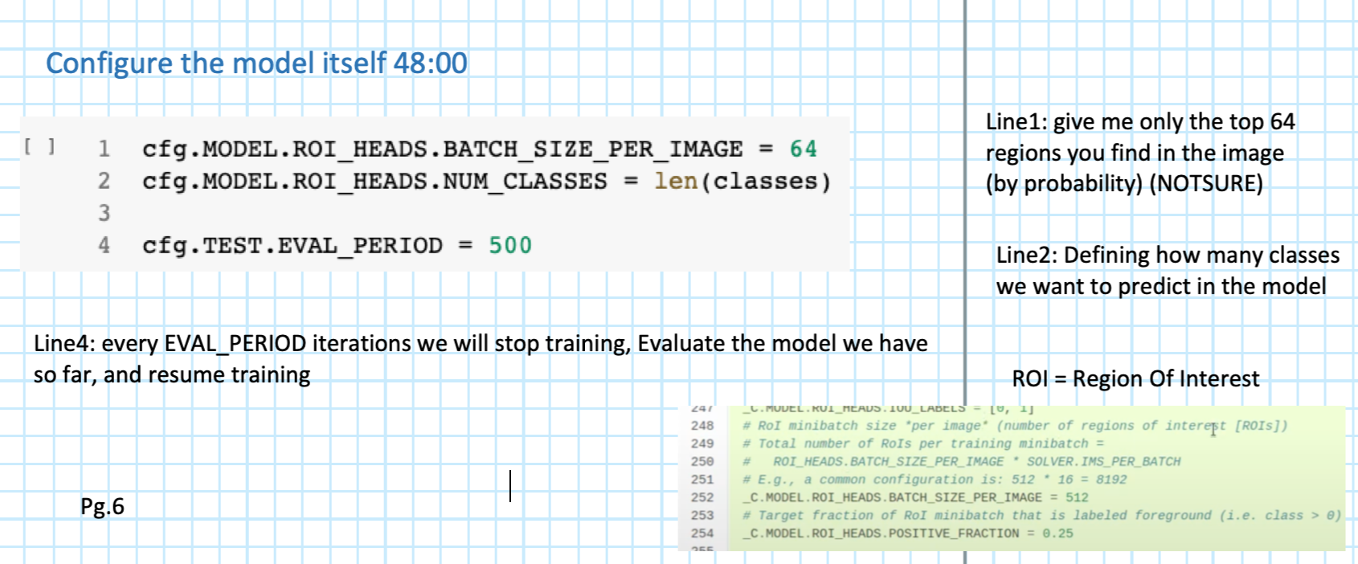
Detectron2 Config Solver

Slide 8
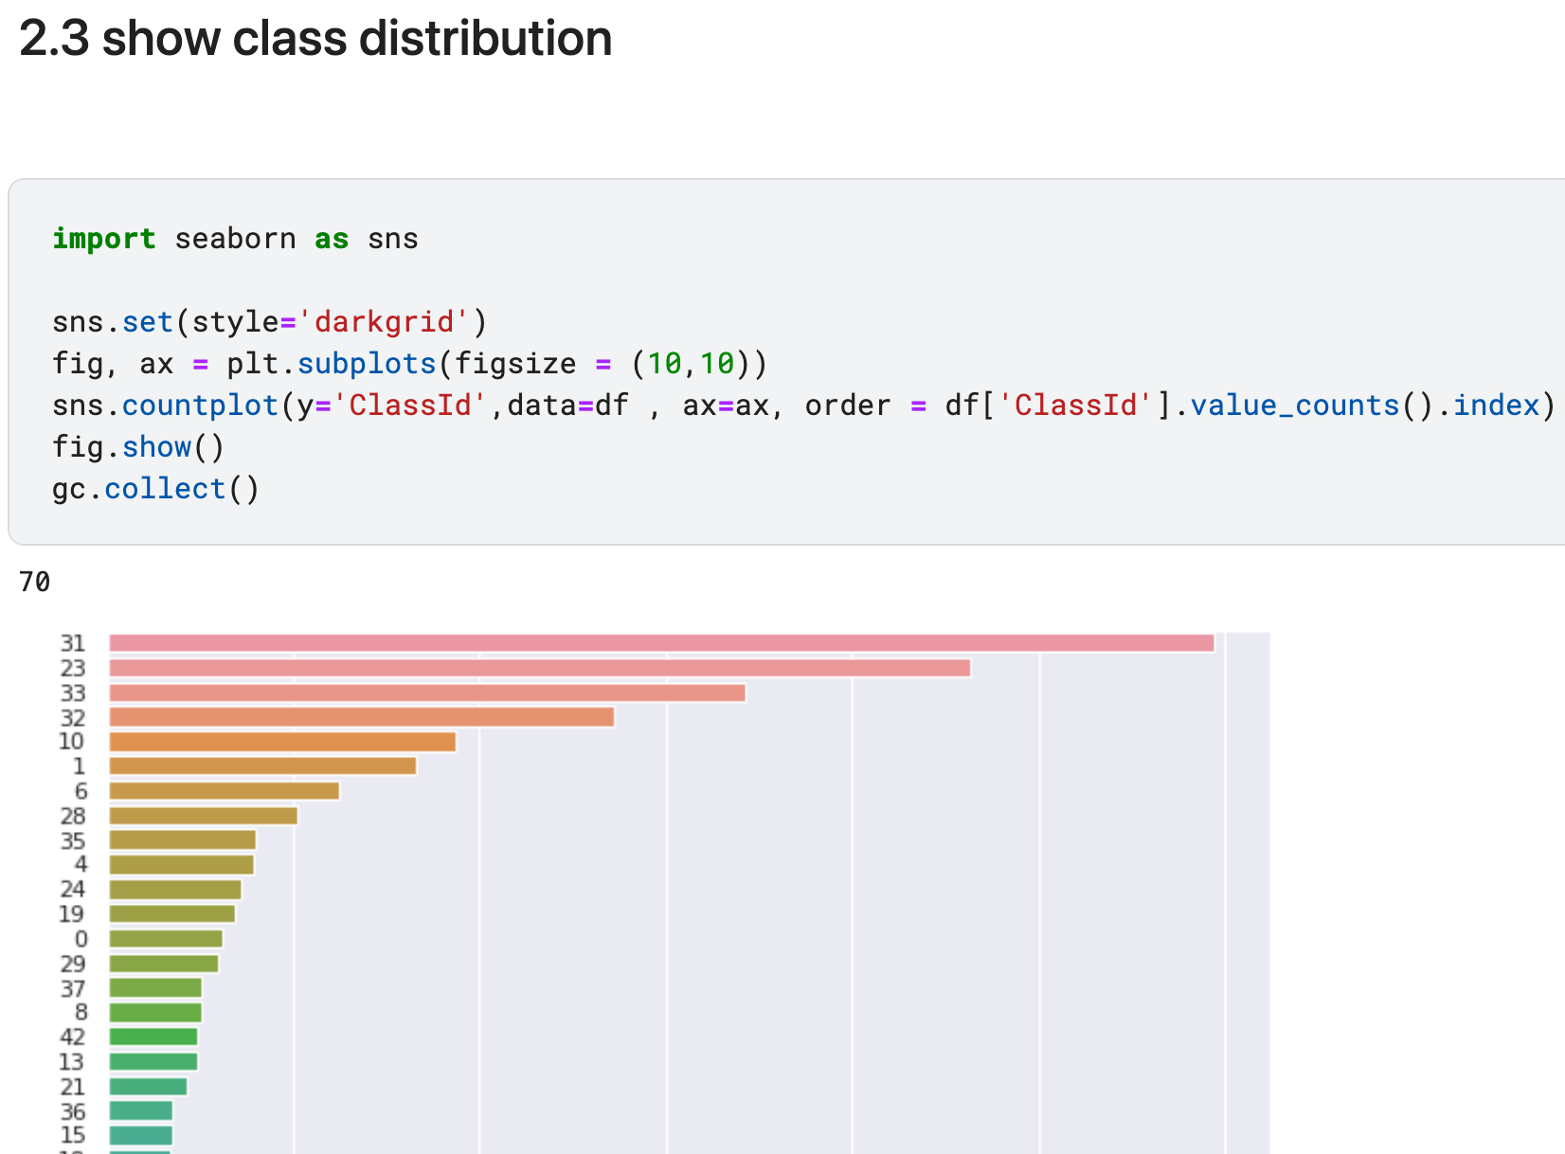
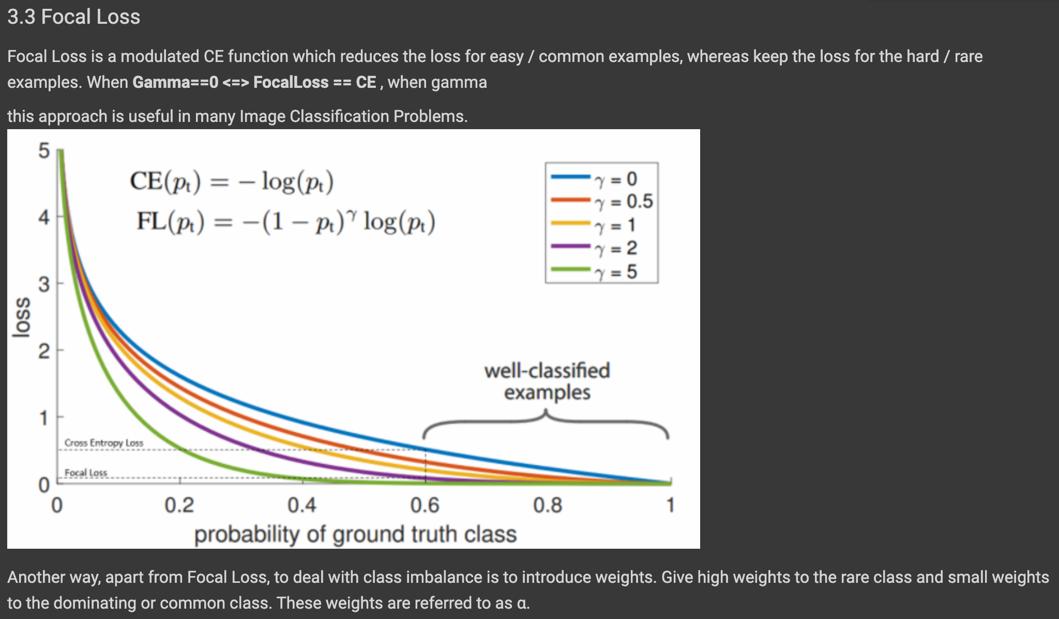
EDA
Noticed imbalance classes
mostly we have
31-sleeve
23 - shoe
33 - necklines
32 - pockets
10 - dresses
We’ve see that our data is unbalance, so we noted, that if we get unbalanced result, we will use Focal loss - lab7

Slide 9
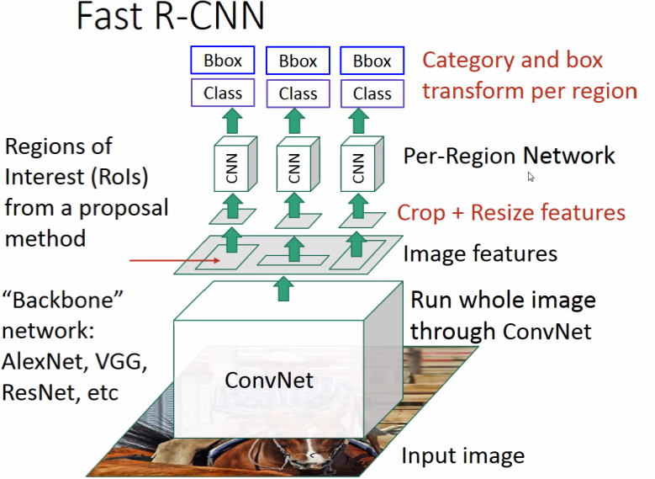
Fast R-CNN Modification
inorder to find Attributes about these items: (In Black)
in order to do that, we had to modify Detectron2’s Fast-RCNN, output. We needed to add another output, aside BBox & Class
attach it to the Per-Region network, Route it’s loss & modify the object.
Attributes

